Slide 1
Phonology and Syntax
Red-Crowned Amazon Parrot

Slide 2
From the proposal presentation and the update presentation, both times I’ve been changing my mind about what to ask of the dataset.
I apologize if it seemed unclear, it was unclear to me too.

Slide 3
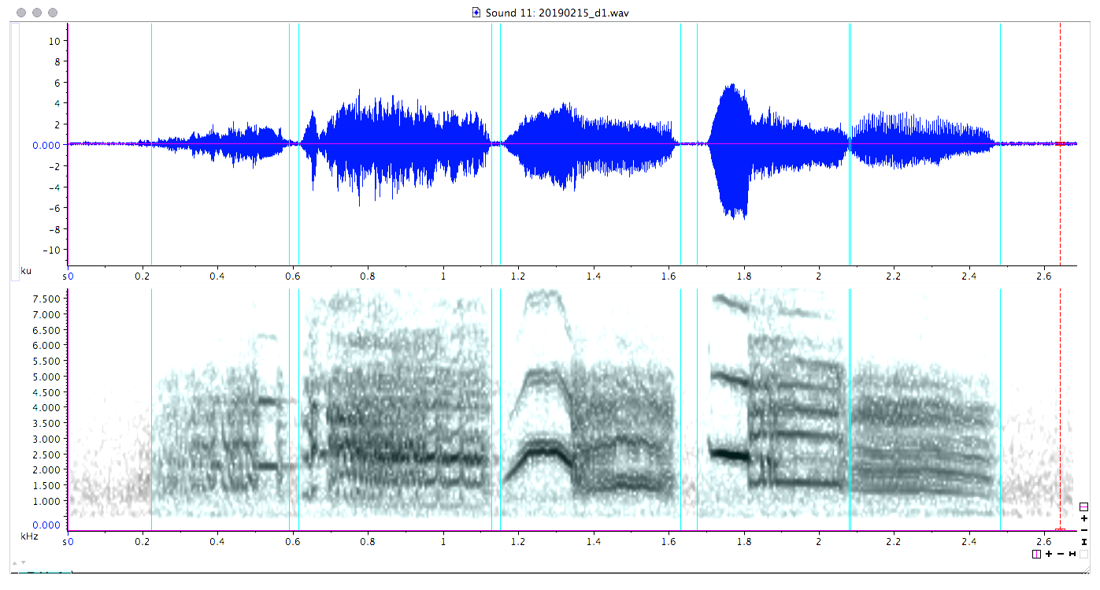
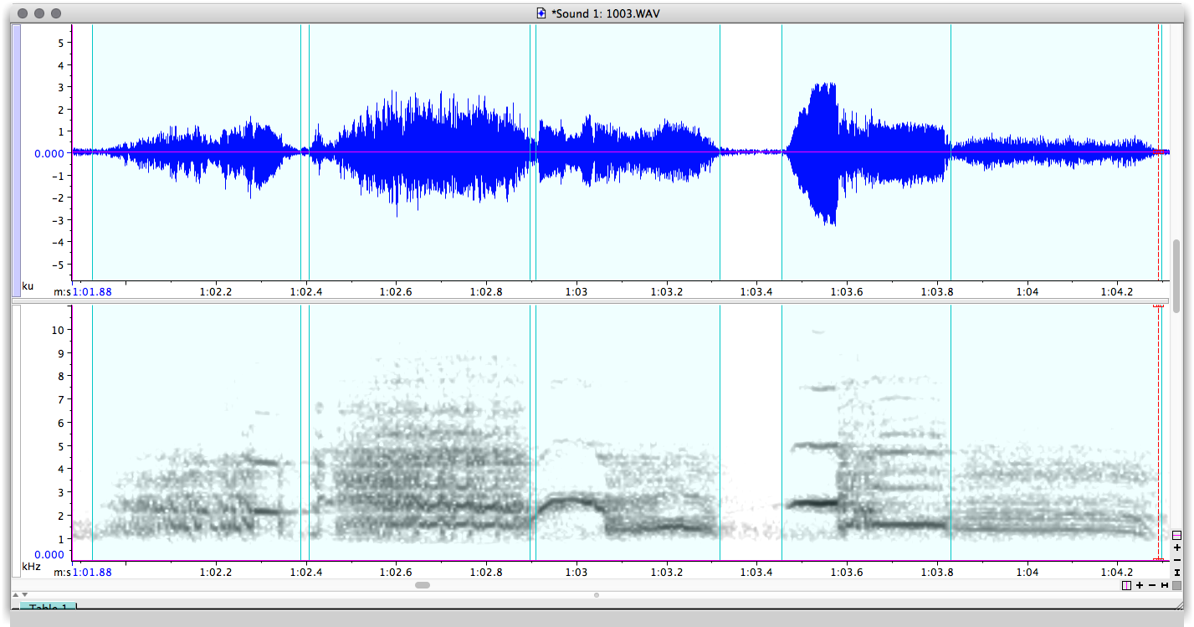
Phonology
34 unique signals manually classified with the use of audio and spectrographic visual representation
94 duets ranging from 4 to 15 signals in length

Slide 4
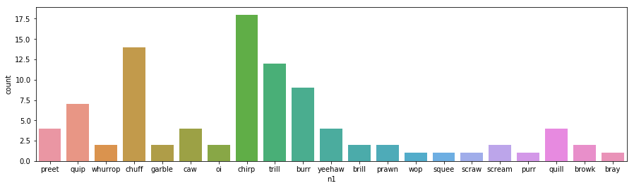
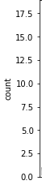
Seaborn Countplot there aren’t many options for visualizing categorical data

Slide 5
String List DataFrame

Slide 6
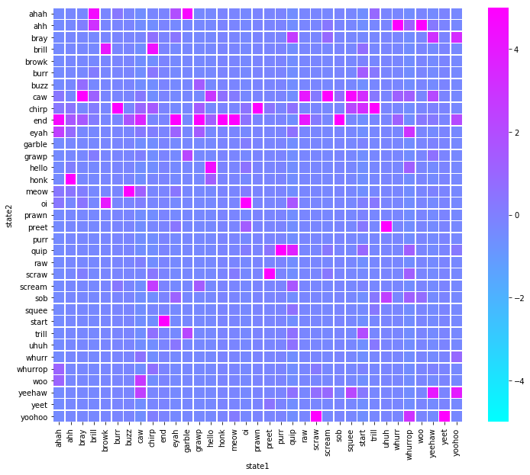
Observed transition probabilities

Slide 7
Transition Dataframe 194 Unique transitions out of 1156 possible grouped

Slide 8
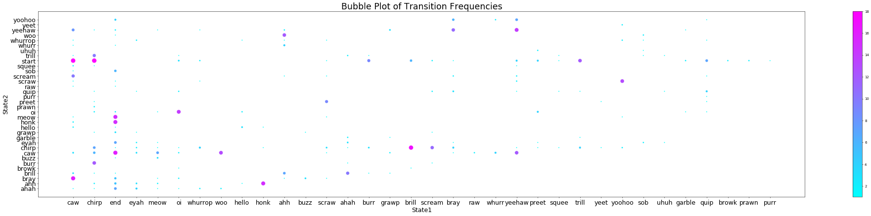
Bubble Plot of Transition Frequencies

Slide 11
Naïve-Bayes Accuracy
The Naive-Bayes Algorithm assumes independence between 'state1' and 'state2' and calculated the probability that any signal could predict the following signal
RESULTS (NB= 0.4359)
Consider that random probability is 0.0588

Slide 12
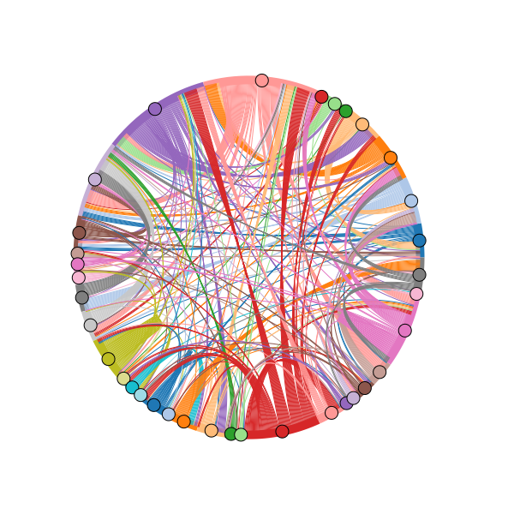
Circular Transition Flows Purple--Chirp Peach--Caw Pink--Yeehaw Red--Start Puce--Oi

Slide 13
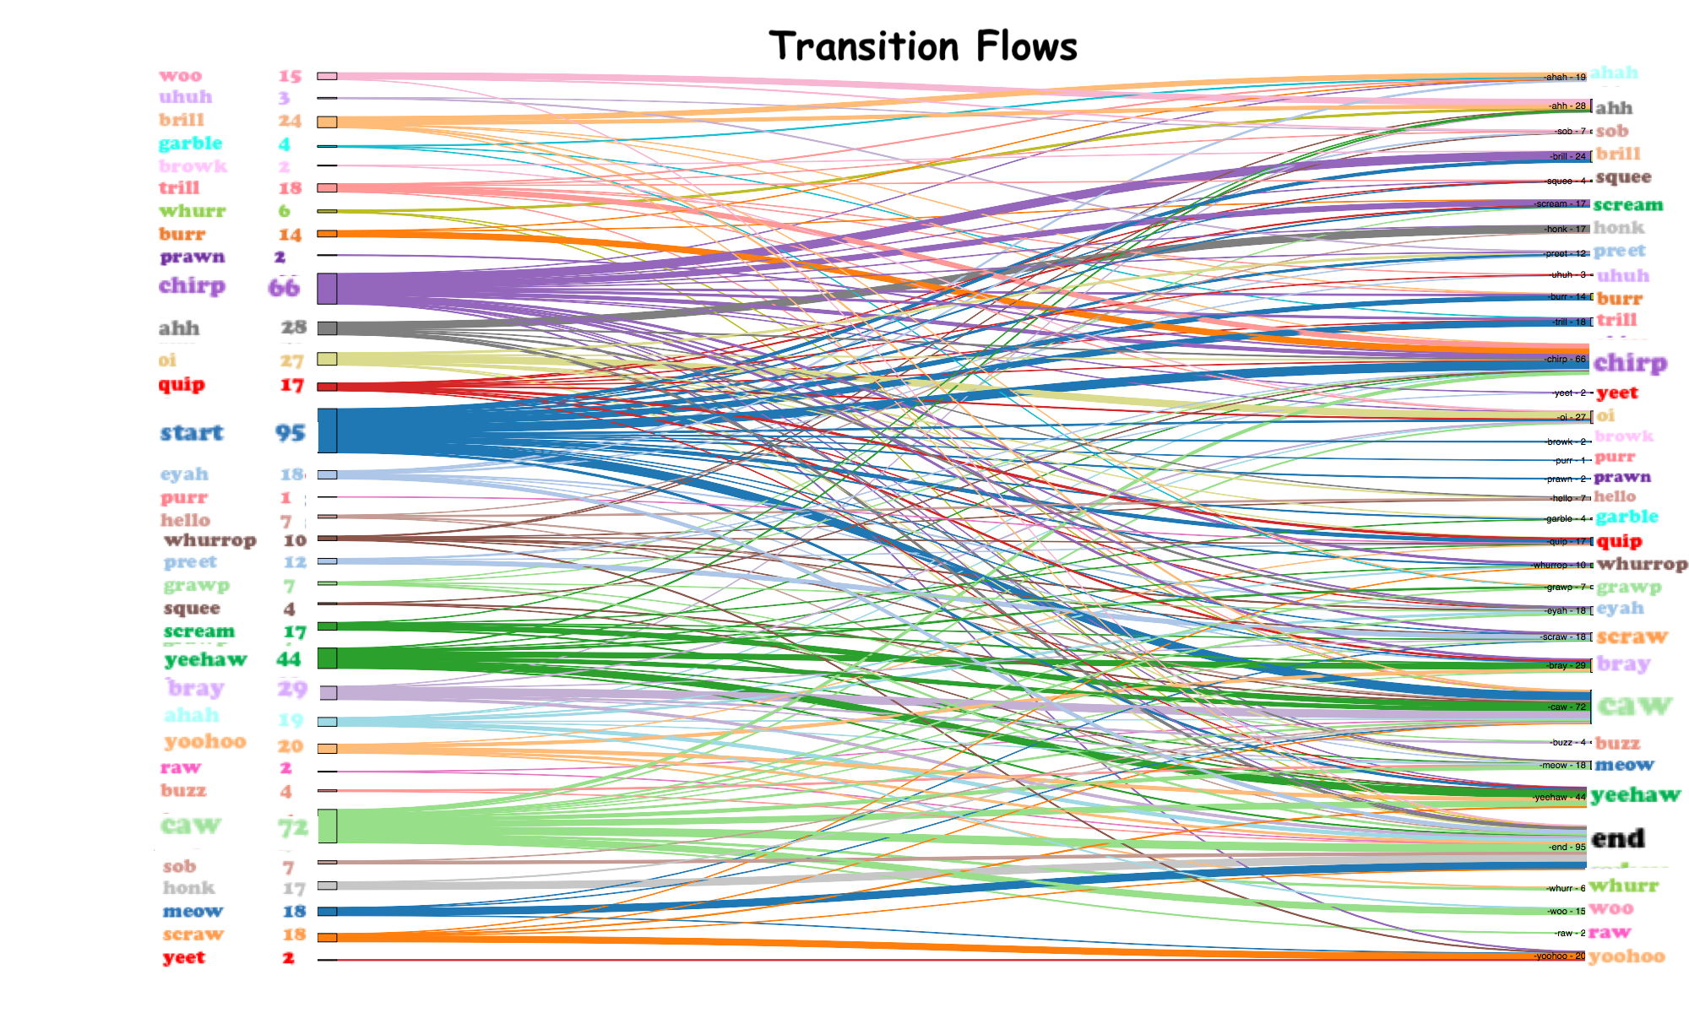

Slide 14
Future Studies

